Slide 1
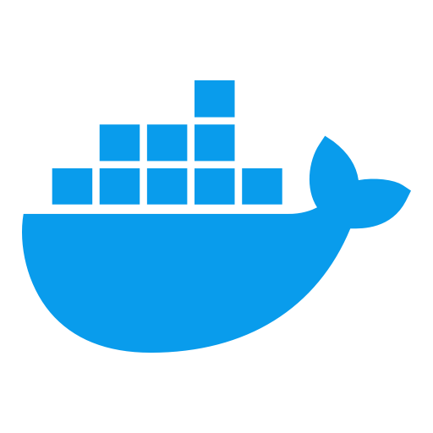



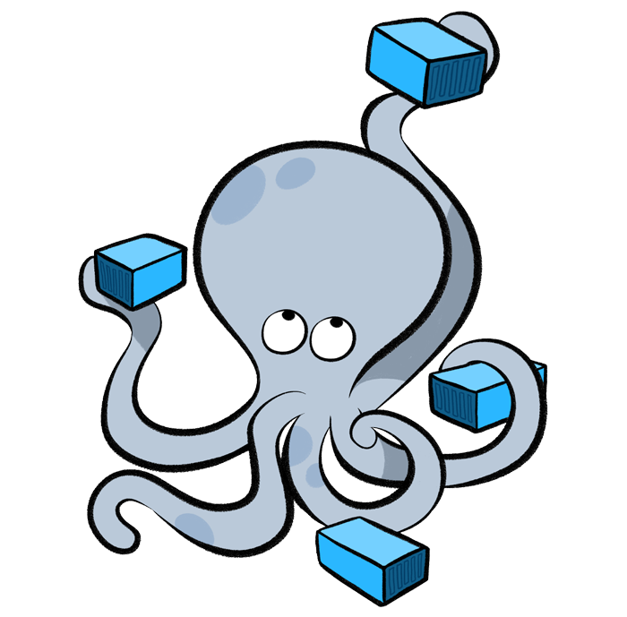





aws.com/apply/123/456
{ origin: prep-app, … }
App
Nginx
Lambda
Website
App
Form Server
Pull Docker Image
aws.com/apply/123/456
{ origin: lockandstock-app, … }
Nginx
Logic to convert Lambda URL to respective domain URL
Form Server
Pull Docker Image
Nginx
Website
Form Server
Pull Docker Image
Form Server
Push Image to Docker Hub

